Slide 1



DSP - PYTHON PROJECT
NOV 2023
Data-Driven Salary Prediction for Data Professionals
An in-depth analysis and modeling project
By: Madiha Raheel
Instructed by: Mr. Vijay Kumar
Notes:
Good morning every one, My name is Madiha Raheel, and today I am here to present my project on salary prediction for data professionals. This project is a part of our Python (DSP) course, under the guidance of our teacher, Mr. Vijay Kumar.
Throughout this presentation, I will be sharing with you my methodology, the data I've collected and analyzed, the models I've built and predictions.
Let's dive into the details.

Slide 2

Introduction
Purpose of Analysis:
To develop a predictive model that estimates data professional salaries based on job features.
Significance for Job Seekers:
Enables informed career decisions by anticipating salary offerings.
Significance for Employers:
Aids in creating competitive salary packages to attract top talent.
Notes:
what this project is all about. Our aim here is simple: we want to predict data professionals' salaries using a variety of job factors. This isn't just academic—it has real-world benefits.
For job seekers, this means getting a clear idea of what salary to expect before you walk into an interview. For employers, it means setting salary levels that are competitive enough to snag the best talent.
In essence, we're bridging the gap between expectations and reality, for everyone's benefit.
Let's move on to see how we did this.

Slide 3
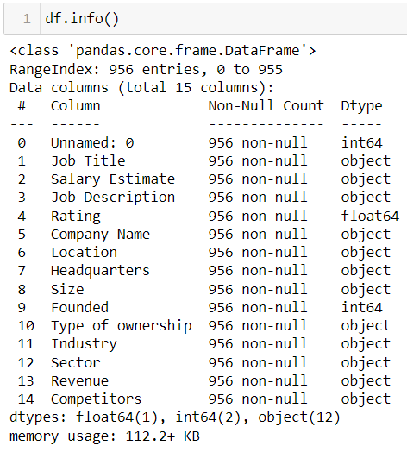
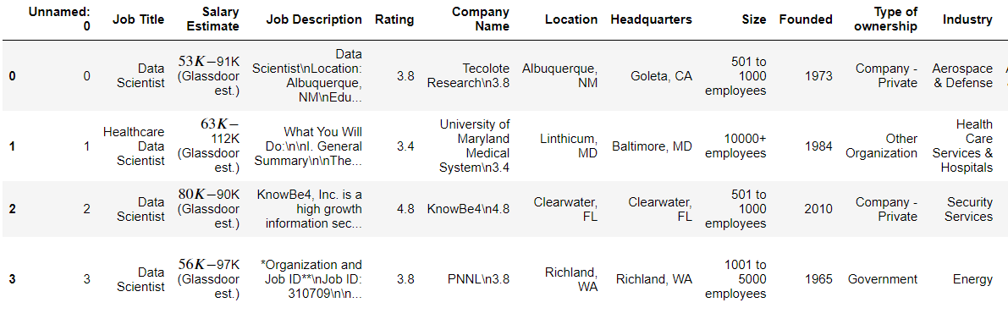
About DATA
Volume:
956 Data Professional Records.
Features:
Job Title, Company Details, Sector, Skills.
Insights:
Ownership Type, Founding Year.
Skills Tracked:
Python, SQL, Tableau.
Prediction Target:
Salaries.
Notes:
On this slide, we're looking at the data i used for my project:
i have records for 956 data professionals.
The data includes information like job titles, companies, sectors, and skills.
We focused on key skills: Python, SQL, and Tableau.
Our main goal is to predict salaries.
Just a quick note: most of the information is in categories, except for company ratings and how long the company has been around, which are numbers.
Now, let's see how we use this data to make predictions.

Slide 4



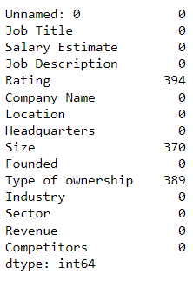
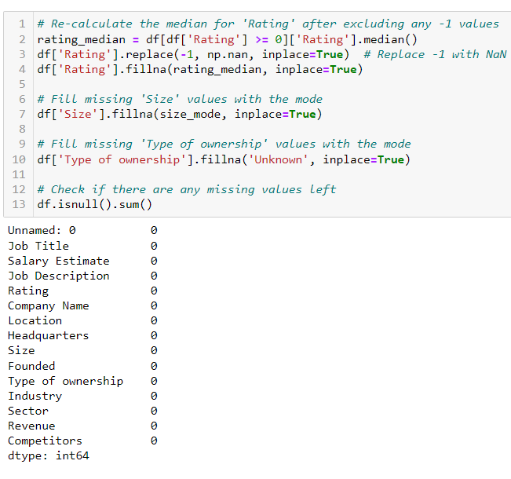
Data
Preprocessing
CLEANING
Applied median imputation for ratings, mode for company sizes, and assigned 'Unknown' for missing ownership types to maintain data consistency.
Handled Missing Values
Notes:
In getting our data ready:
I fixed missing values to make sure our data was complete.
For missing ratings, I used the median
For company sizes, i used the most common size.
for the ownership type, i just marked it as 'Unknown'.
This prep work helps us make better salary predictions.
Let's see what comes next.

Slide 5
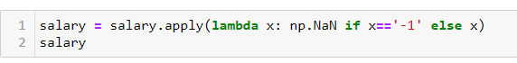
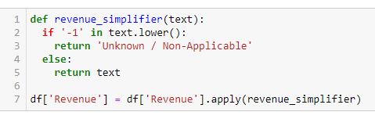
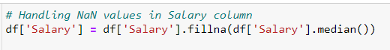
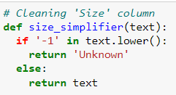
Data
Preprocessing
CLEANING
Revenew, Sector,industry,Type of ownership, size,Salary, Competitors features have -1 values, filled them with ‘Unknown’ too.
Notes:
In cleaning our data, i found that features like Revenue, Sector, Industry, Type of Ownership, Company Size, Salary, and Competitors sometimes had a "-1" value, which doesn't really make sense for our analysis.
So, what did i do? i replaced all these "-1" values with 'Unknown'. This way, our data stays consistent and ready for accurate prediction.

Slide 6
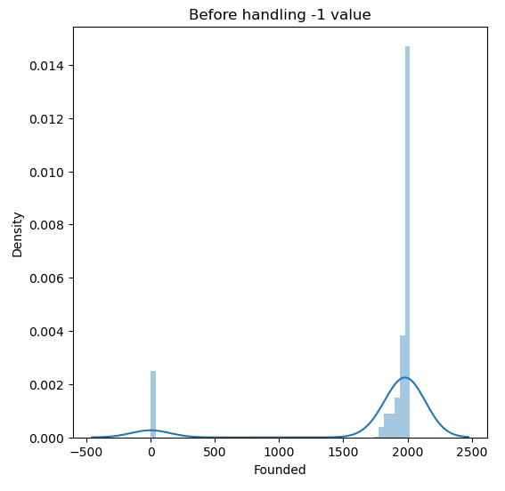
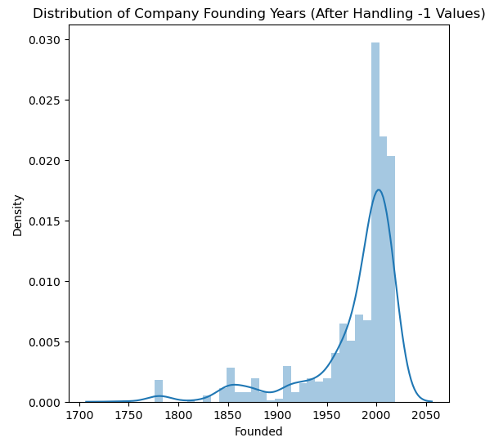

Data
Preprocessing
CLEANING (CONT)
Notes:
here you can see the founded column before and after handling _1 values. lets see further

Slide 7
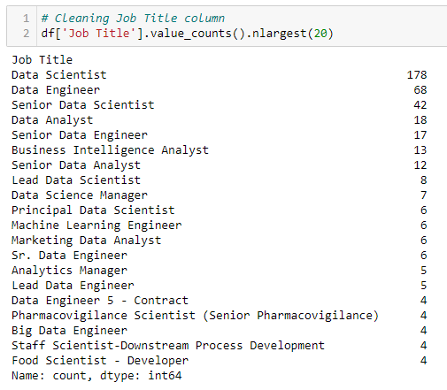
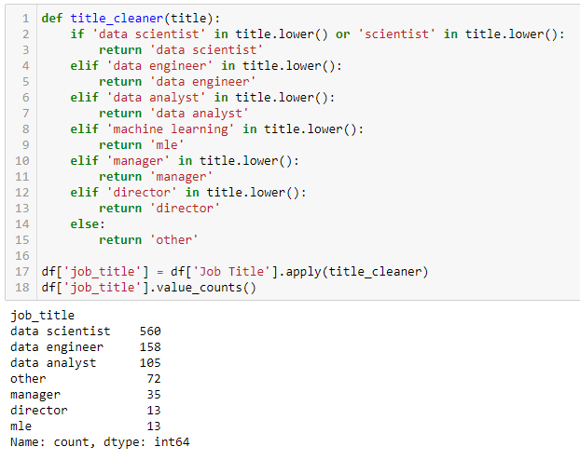
Data Preprocessing
CLEANING (CONT)
Notes:
When i examined the job title column, I noticed a wide range of specific titles. To simplify our analysis, i categorized these titles into 7 distinct bins. This classification is illustrated in the charts you see here.
Each bin represents a grouping of job titles with similar roles or levels.

Slide 8


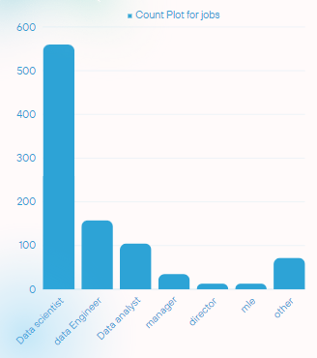
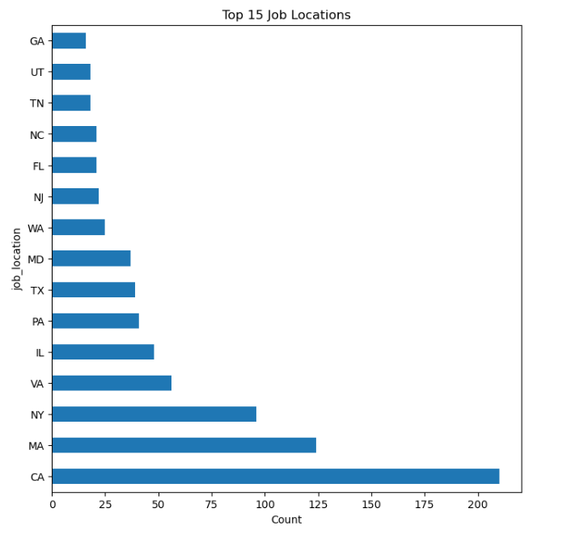
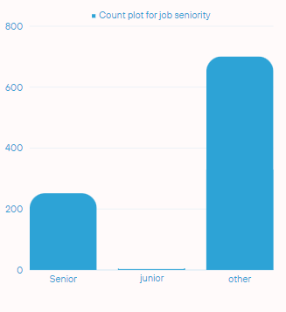

EDA - Exploratory Data Analysis
UniVariate
Notes:
In our analysis, i've got three key visuals:
A count plot for different job titles, showing which ones are most common.
A count plot for job seniority, highlighting whether most jobs are junior, senior, or other.
A chart of the top 15 job locations, so we can see where data jobs are mostly located.
These charts help us quickly see the biggest trends in our data.

Slide 9

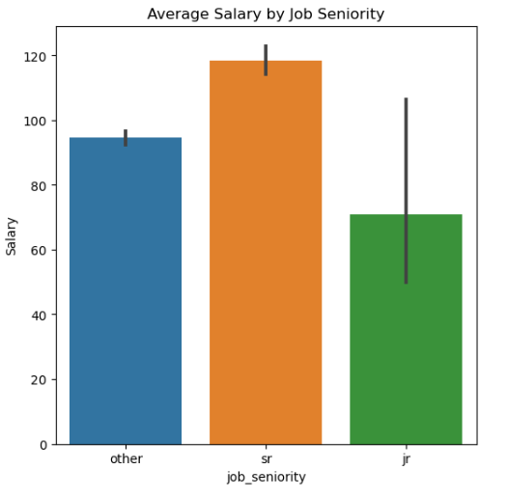
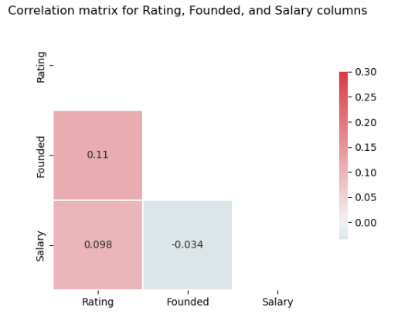
Bivariate Analysis
Indicates a clear trend where increased seniority is associated with higher salary levels.
Low positive and slight negative correlations detected; no multicollinearity present.
Notes:
In our bivariate analysis,
There's a clear pattern that as job seniority goes up, so does salary. This means more experienced professionals tend to earn more.
i've also checked how different factors relate to each other. Some are slightly positively related, and some are slightly negative, but there's no strong overlap, or what we call multicollinearity

Slide 10
Feature Engineering
Created new features
Adding column of job_in_headquarters
Adding columns of python, excel, sql, tableau jobs
Trimming Columns
Features having more than 10 categories are trimmed so as to reduce the dimensionality.
Simplifying the Dataset: Removed unnecessary details to improve the prediction model.
Took out the salary range, only kept the average salary.
Removed company names and locations since they're not used in predictions.
Kept the 'Sector' column and got rid of 'Industry' for more specific analysis.
Simplified the job location information by reducing the number of categories.
Managing Ordered Data
Treated ordinal categories with inherent ranking, like size and rating.
Categorizing Unordered Data
Processed nominal features without numerical significance, such as job titles
Notes:
With feature engineering, i've refined our dataset to better predict salaries:
i added new columns, like whether a job is at the company's headquarters and whether it requires key skills like Python or SQL.
To make the data easier to work with, i trimmed down features with too many categories.
i simplified the dataset by keeping only the average salary and removing less important details like company names.
For job locations, i've consolidated them into fewer categories for a clearer analysis.
i've also organized the data better by treating company size and ratings as ordered categories, since they have a natural order.
Finally, i categorized job titles properly to ensure our model treats them correctly without any numerical assumptions.

Slide 11
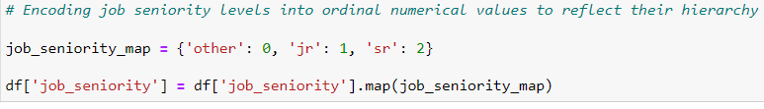
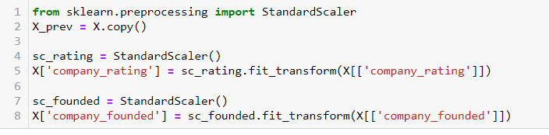
Feature Engineering (cont)
ENCODING & STANDARDIZATION
Applied one-hot encoding to transform categorical variables and standardized numerical features to normalize the data scale.
Categorical to Numerical.
Scaled Numeric Features.
Notes:
In feature engineering, i:

Slide 12
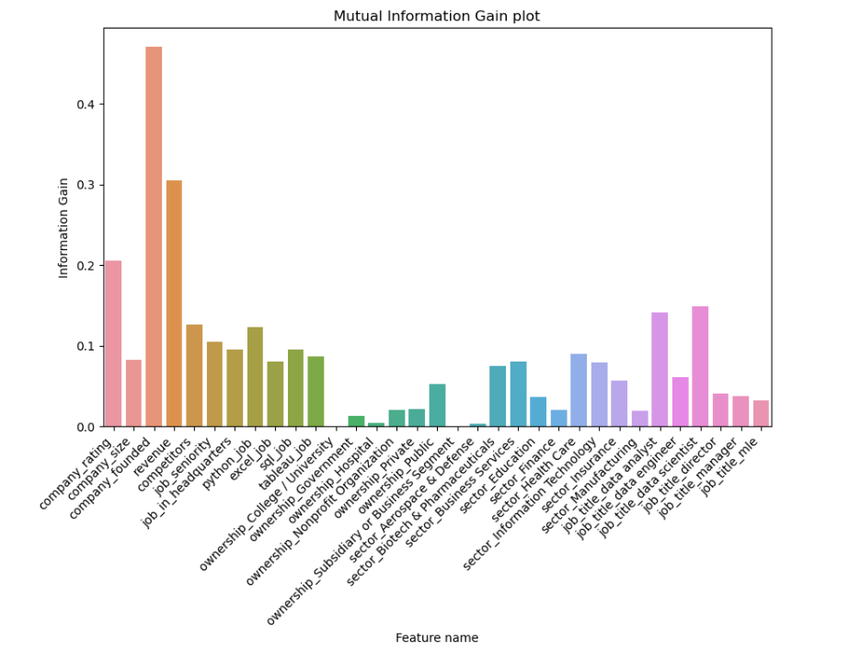
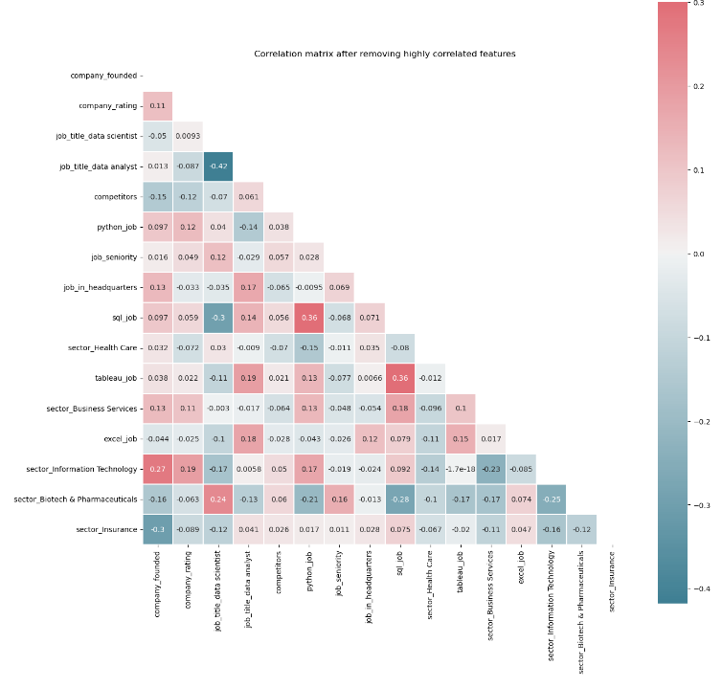

Feature Engineering (cont)
Feature Selection
Selecting features based on information gain (mutual_info_regression) and correlation matrix
company_founded
company_rating
job_title_data scientist
job_title_data analyst
competitors
python_job
job_seniority
job_in_headquarters
sql_job
sector_Health Care
tableau_job
sector_Business Services
excel_job
sector_Information Technology
sector_Biotech & Pharmaceuticals
sector_Insurance
It is evident that there are atleast 20 features that impact the target variable.
Notes:
Next, in feature engineering, ifocused on choosing the right features:

Slide 13
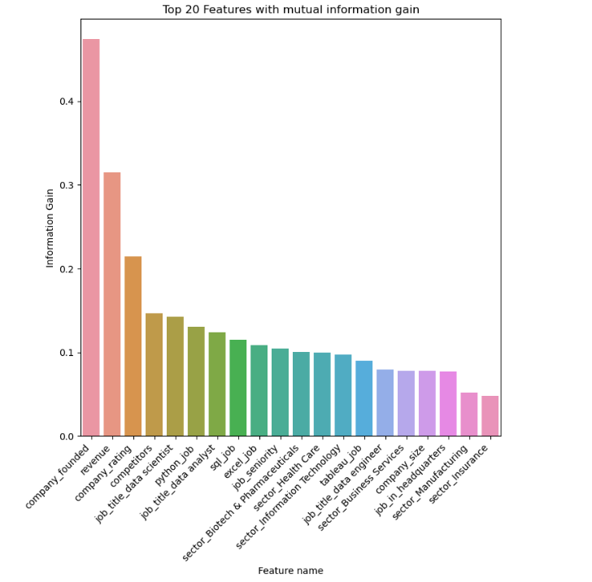
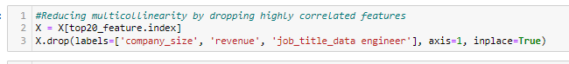
Feature Engineering (cont)
DIMENSIONALITY
CHALLENGES
Addressed Multicollinearity.
Reduced via Feature Selection.
Implemented feature selection to manage dimensionality and eliminated multicollinearity by excluding correlated predictors.

Slide 14
RANDOM FOREST
LINEAR
REGRESSION
R2 = 0.3034
MSE = 747.6485
MAE = 20.4776
R2 = 0.6545
MSE = 370.6757
MAE = 12.5351
Model Building & Evaluation
LASSO
REGRESSION
DECISION TREE
R2 = 0.2801
MSE = 772.6367
MAE = 20.752
R2 = 0.3669
MSE = 679.5632
MAE = 15.4767
GRADIENT BOOSTING
R2 = 0.4627
MSE = 576.6693
MAE = 18.02149
SVM
KNEIGHBORS
R2 = 0.1194
MSE = 945.1463
MAE = 21.8070
R2 = 0.3861
MSE = 658.9004
MAE = 17.6510
Notes:
i tried out many models to see which one guesses salaries the best. i looked at Linear Regression, KNN, Decision Trees, Random Forest, SVM, Lasso, and Gradient Boosting.
the Random Forest was the best at predicting salaries. Gradient Boosting was also good, just not as strong. The other models were okay, but not as effective as these two.

Slide 15
Insights
MODEL PERFORMANCE:
The Random Forest outperformed other models, effectively managing the dataset's complexity.
FEATURE IMPORTANCE:
Certain features, such as company_rating, job_seniority, and specific technical skills (python, sql, tableau), were significant predictors of salary.
SECTOR INFLUENCE:
The sector (e.g., Information Technology, Health Care) significantly influenced salary predictions.
COMPANY CHARACTERISTICS:
Features related to company characteristics (e.g., company_founded, type of ownership) had varying degrees of influence on salary
Notes:
Our findings show:
Random Forest topped our model list for salary predictions.
Higher company ratings, job seniority, and tech skills correlate with better salary.
Industry type and company background also influence salary levels.

Slide 16

Case Study: Predicting Salary for Data Scientist
Based on the following features using Random Forest Algorithm
Title: Data analyst
Location: Headquarters
Seniority: junior
Languages: Python
Tools: Tableau
Rating: 3
Foundation Year: 2000
Competitors: 1
Sector: Health Care
Ownership: Public
Predicted Salary Range:
$63,085(USD) to $81,085(USD) per annum.
Notes:
Let's look at a real example. We used our Random Forest model to predict the salary for a 'Data Analyst' role. Here's the job profile we considered:
Title: Data Analyst
Works at the company's headquarters
Junior level position
Knows Python and Tableau
Company has a rating of 3
Founded in the year 2000
Has one competitor
In the Health Care sector
Publicly owned company
And according to our model, such a Data Analyst can expect to earn between $63,085 to $81,085 a year.
This shows how our model can help in estimating salaries for specific data science roles.

Slide 17

Thank you

